Slide 1
SUMMER TRAINING REPORT

Slide 2
PLATFORM: BOARD INFINITY
COURSE NAME: MICROLEARING PROGRAM FOR JAVASCRIPT

Slide 3

INTRODUCTION: BOARD INFINITY
Board Infinity stands as a cutting-edge online learning
platform that offers an extensive array of courses and
programs tailored to help individuals cultivate fresh
skills and propel their careers forward. The platform
distinguishes itself by its practical and industry-centric
approach, delivering knowledge through micro-learning
modules. These compact and easily digestible segments
grant learners swift access to content that's highly
relevant in real-world scenarios.

Slide 4
INTRODUCTION: JAVASCRIPT
The inception of JavaScript can be attributed to
Brendan Eich during his tenure at Netscape
Communications in the mid-1990s. Initially dubbed
"Mocha" and later rebranded as "LiveScript," the
language eventually adopted the name JavaScript to
capitalize on the growing popularity of Java. It's
important to note that while the names are linked,
JavaScript and Java are distinct languages, each serving unique purposes.

Slide 5
The role of JavaScript in web development centers on elevating user experiences by introducing interactivity and dynamism to websites and web applications. Unlike HTML (Hypertext Markup Language) and CSS (Cascading Style Sheets), which handle structure and presentation respectively, JavaScript is dedicated to behavior and functionality.
In the contemporary landscape, JavaScript has become an indispensable component of modern web development, enabling the creation of everything from basic interactive widgets to intricate single-page applications (SPAs). It underpins critical features including form validation, real-time updates, interactive maps, multimedia playback, animations, and more.
ROLES IN WEB DEVELOPMENT

Slide 6
FUNDAMENT-ALS OF JAVASCRIPT
JavaScript, often abbreviated as JS, stands as a versatile
and extensively utilized programming language
renowned for its pivotal role in the domain of web
development. It empowers the creation of dynamic and
interactive content on web pages, enriching user
experiences through the integration of functionality,
interactivity, and responsiveness. Within the realm of
modern web development, JavaScript assumes a
foundational role, empowering developers to craft a
diverse range of creations, spanning from
straightforward interactive elements to intricate web
applications.

Slide 7
WHY TO USE JAVASCRIPT
JavaScript, HTML, and CSS are foundational
technologies in web development, each serving distinct roles, often working in harmony to create dynamic, interactive websites. Using JavaScript alongside HTML and CSS offers several benefits:
Form Validation and User Feedback
Real-time Updates and Data Manipulation
Interactivity and User Experience Enhancement
Animations and Visual Effects

Slide 8
PROJECTS

Slide 9

DIGITAL CLOCK
I have built a digital clock that should display the current me and update the time after every second. When the user clicks the `Stop` Button on the clock should stop updating the me. When the user clicks on the `Start` button later the clock should start updating the current time again

Slide 10


Slide 11
I have also made a project on a random quote generator in which I had made a quote generator which works according to me when a subject uses it along with every quote The background color also changes.
PROJECT 2: RANDOM QUOTE GENERATOR

Slide 12
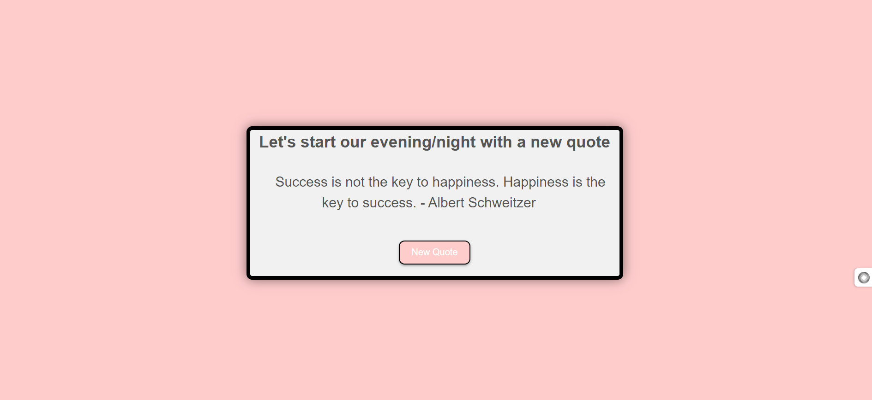

Slide 13
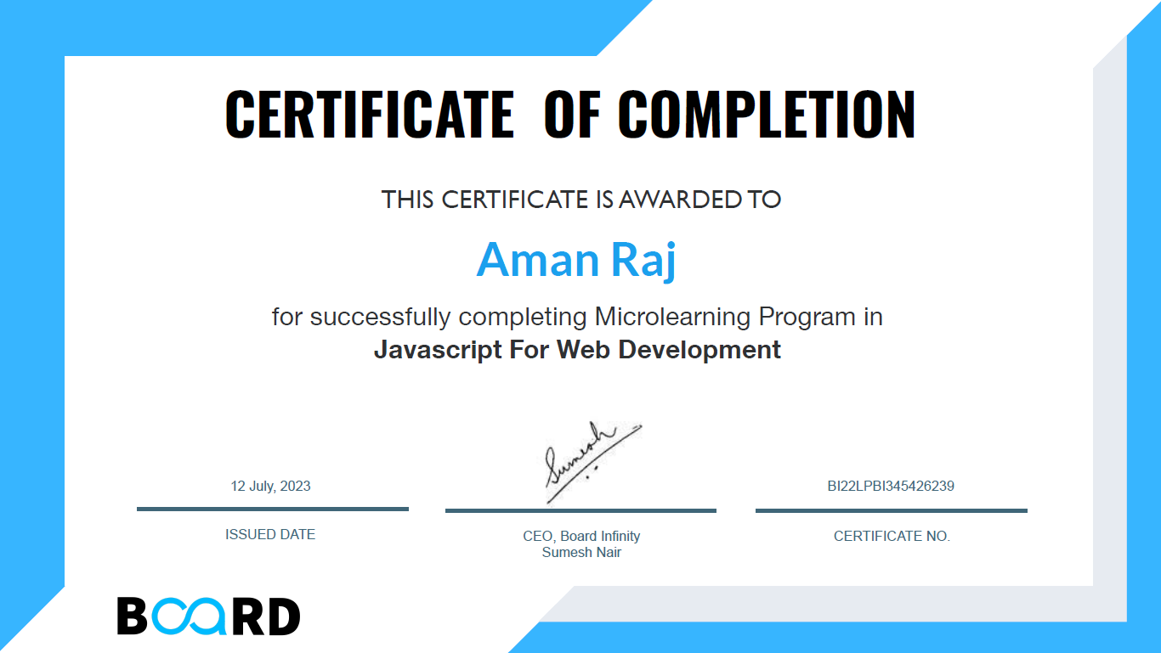

Slide 14
JavaScript is a fundamental language in the world of web development, serving as the backbone for many modern technologies. React.js and React Native are two JavaScript libraries that have transformed the way we create web and mobile applications.
React.js, or React, is a JavaScript library developed by Facebook. It offers a component-based approach to building user interfaces, making it easier to create dynamic and responsive web applications. By breaking down UI elements into reusable components, React promotes code reusability and maintainability. Its declarative style simplifies UI development by allowing developers to describe how the UI should look in different states.
React Native, an extension of React, lets you build mobile apps for iOS and Android using JavaScript. It's a game-changer for developers who want cross-platform compatibility. With React Native, you write code once and run it on multiple platforms, saving time and effort. It provides access to native components and APIs, ensuring your apps feel native.
Both React.js and React Native have active communities, offering resources, libraries, and tools to streamline development. They prioritize performance, delivering smooth user experiences. Mastering these technologies equips you to efficiently create modern web and mobile applications, opening up exciting opportunities in software development.
FURTHER PLANS

Slide 15

CONCLUSION
In conclusion, the course on JavaScript from Board
Infinity has been an immensely beneficial journey that
has significantly enhanced my understanding and
proficiency in the realm of web development. Through
the well-structured curriculum and the guidance of
experienced instructors, I have not only gained a solid
grasp of the core concepts of JavaScript but also
developed the skills to effectively apply them in real-
world scenarios.

